Slide 1
CSE 495 (Natural Language Processing) Lecture 10
Decoder only Transformers

Slide 2
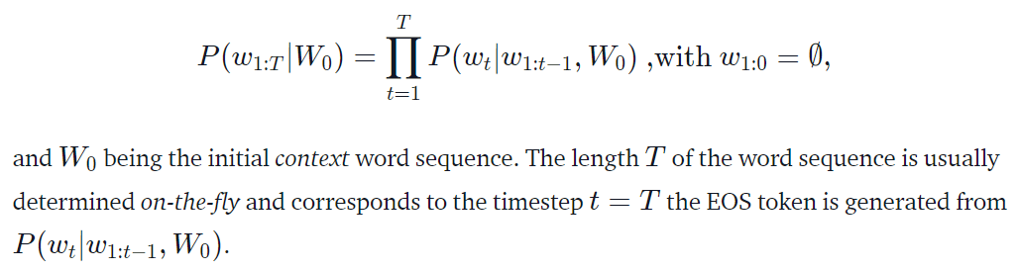
Language Model
Auto-regressive language generation assumes that the probability distribution of a word sequence can be decomposed into the product of conditional next word distributions

Slide 3
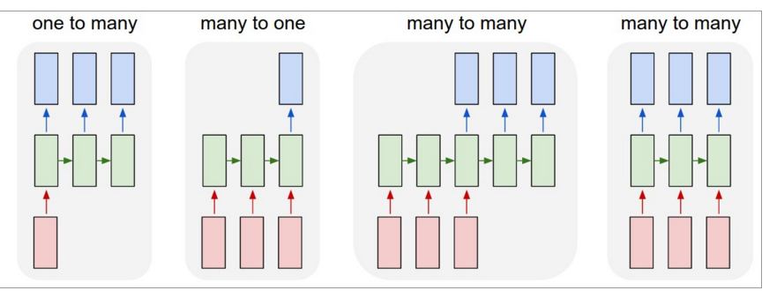
LSTMs can be used for other sequence tasks
image captioning
sequence classification
named entity recognition
translation
http://karpathy.github.io/2015/05/21/rnn-effectiveness/

Slide 4
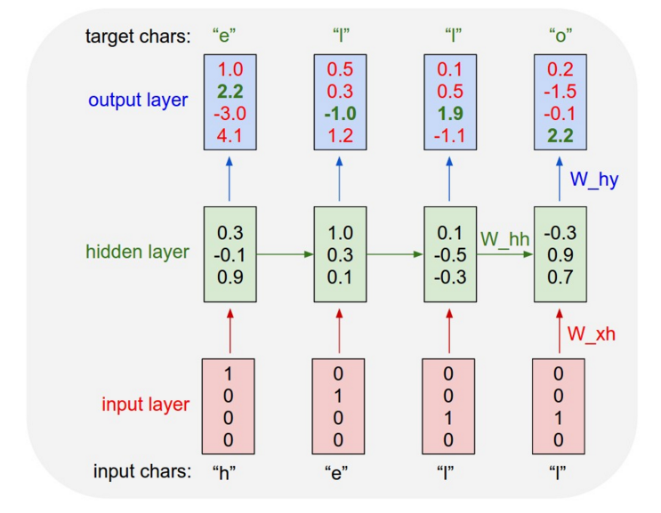
Character-level language model
Test time:
pick a seed character sequence
generate the next character
then the next
then the next …
http://karpathy.github.io/2015/05/21/rnn-effectiveness/

Slide 5
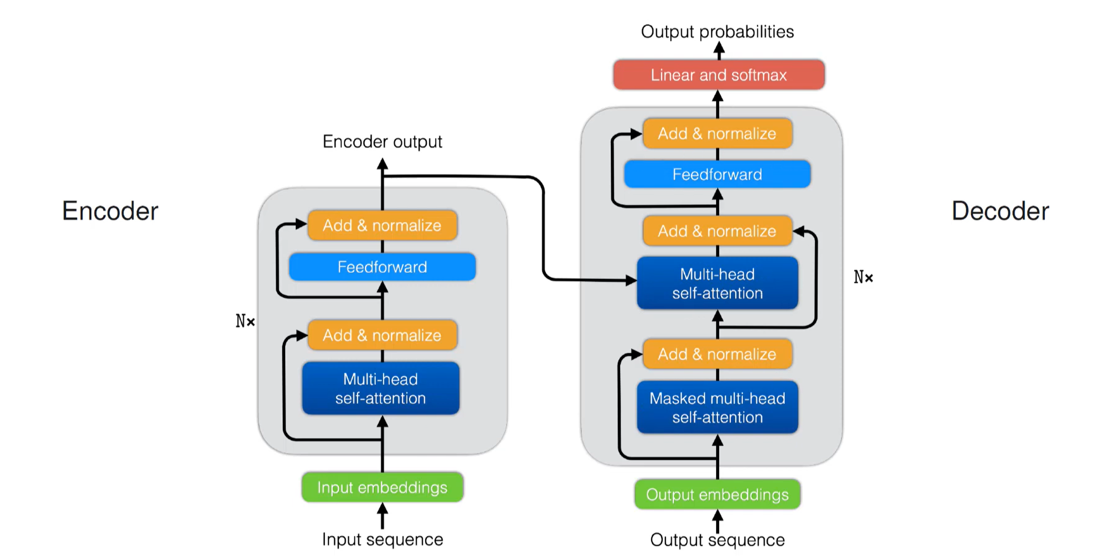
Encoder-Decoder Transformer

Slide 6
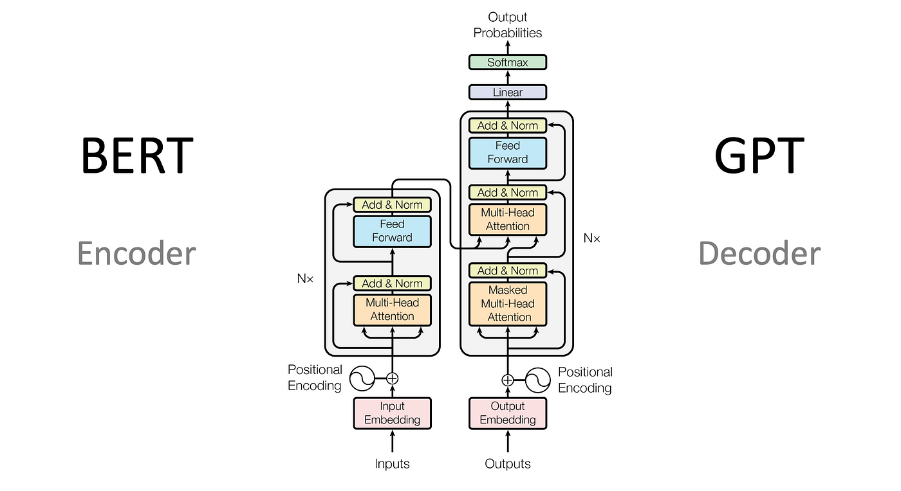
Decoder Only

Slide 8
GPT: Text generation

Slide 9
Text generation using GPTx
How can we control content generation with an unconditioned language model?
We use different sampling techniques

Slide 10
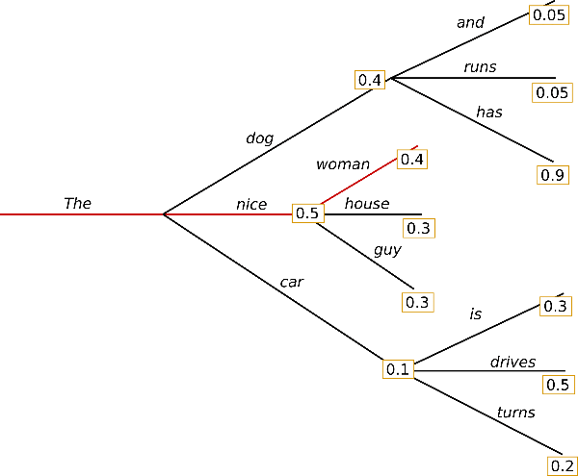
Text generation: Greedy decoding
Greedy decoding: Always pick the next token with the highest probability

Slide 11
Problems of Greedy Decoding
The generated words following the context are reasonable for greedy decoding.
But the model quickly starts repeating itself!
This is a very common problem in language generation in general and even more so in greedy and beam searches.
Another major drawback of greedy decoding is it misses high-probability words hidden behind a low-probability word
The word "has“ with its high conditional probability of 0.9, is hidden behind the word "dog,” which has only the second-highest conditional probability, so that greedy search misses the word sequence "The", "dog", "has"

Slide 12
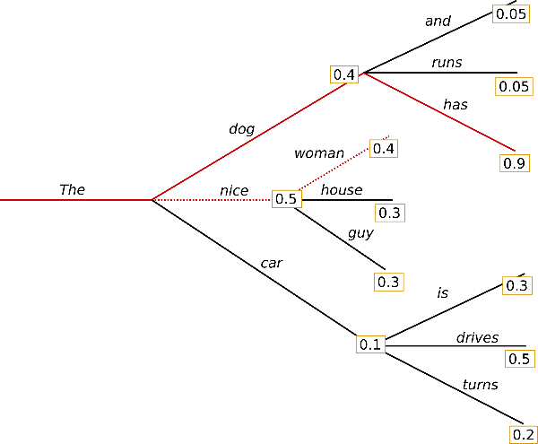
Text generation: Beam search
Beam search reduces the risk of missing hidden high probability word sequences by keeping the most likely num_beams of hypotheses at each time step and eventually choosing the hypothesis that has the overall highest probability. Let's illustrate with num_beams=2:

Slide 13
Beam Decoding
Besides the most likely hypothesis ("The","nice"), beam search also keeps track of the other probable sequences ordered by probability vaulues [here second most likely one ("The","dog")].
In the previous example, beam search finds that the word sequence ("The","dog","has"), has a probability of 0.36
Higher probability than ("The","nice","woman"), which has 0.2
Beam search will almost always find an output sequence with a higher probability than greedy search but is not guaranteed to find the most likely output.
While the text generated usually are fluent, the output will eventually include repetitions of identical word sequences.
A simple remedy is introducing n-grams penalties.
The most common n-gram penalty ensures that no n-gram appears twice by manually setting the probability of the following words that could create an already seen n-gram to 0.

Slide 14
Beam Decoding vs Greedy Decoding
Greedy Search considers each position in isolation
After identifying the best word for that position, it does not examine what comes before it (ie. in the previous position), or after it.
In contrast, Beam Search picks the ’N’ best sequences so far and considers the probabilities of the combination of all of the preceding words along with the word in the current position.

Slide 15
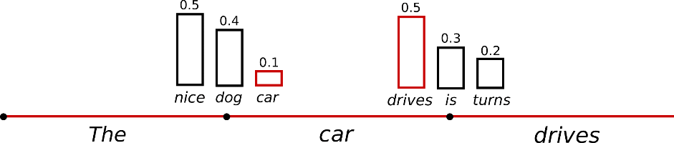
Text generation: Sampling
In its most basic form, sampling means randomly picking the next word w_{t} according to its conditional probability distribution

Slide 16
Sampling Decoding
It is obvious that language generation using sampling is not deterministic anymore.
The word ("car") is sampled from the conditioned probability distribution P(w∣"The"), followed by sampling ("drives") from P(w∣"The","car").

Slide 17
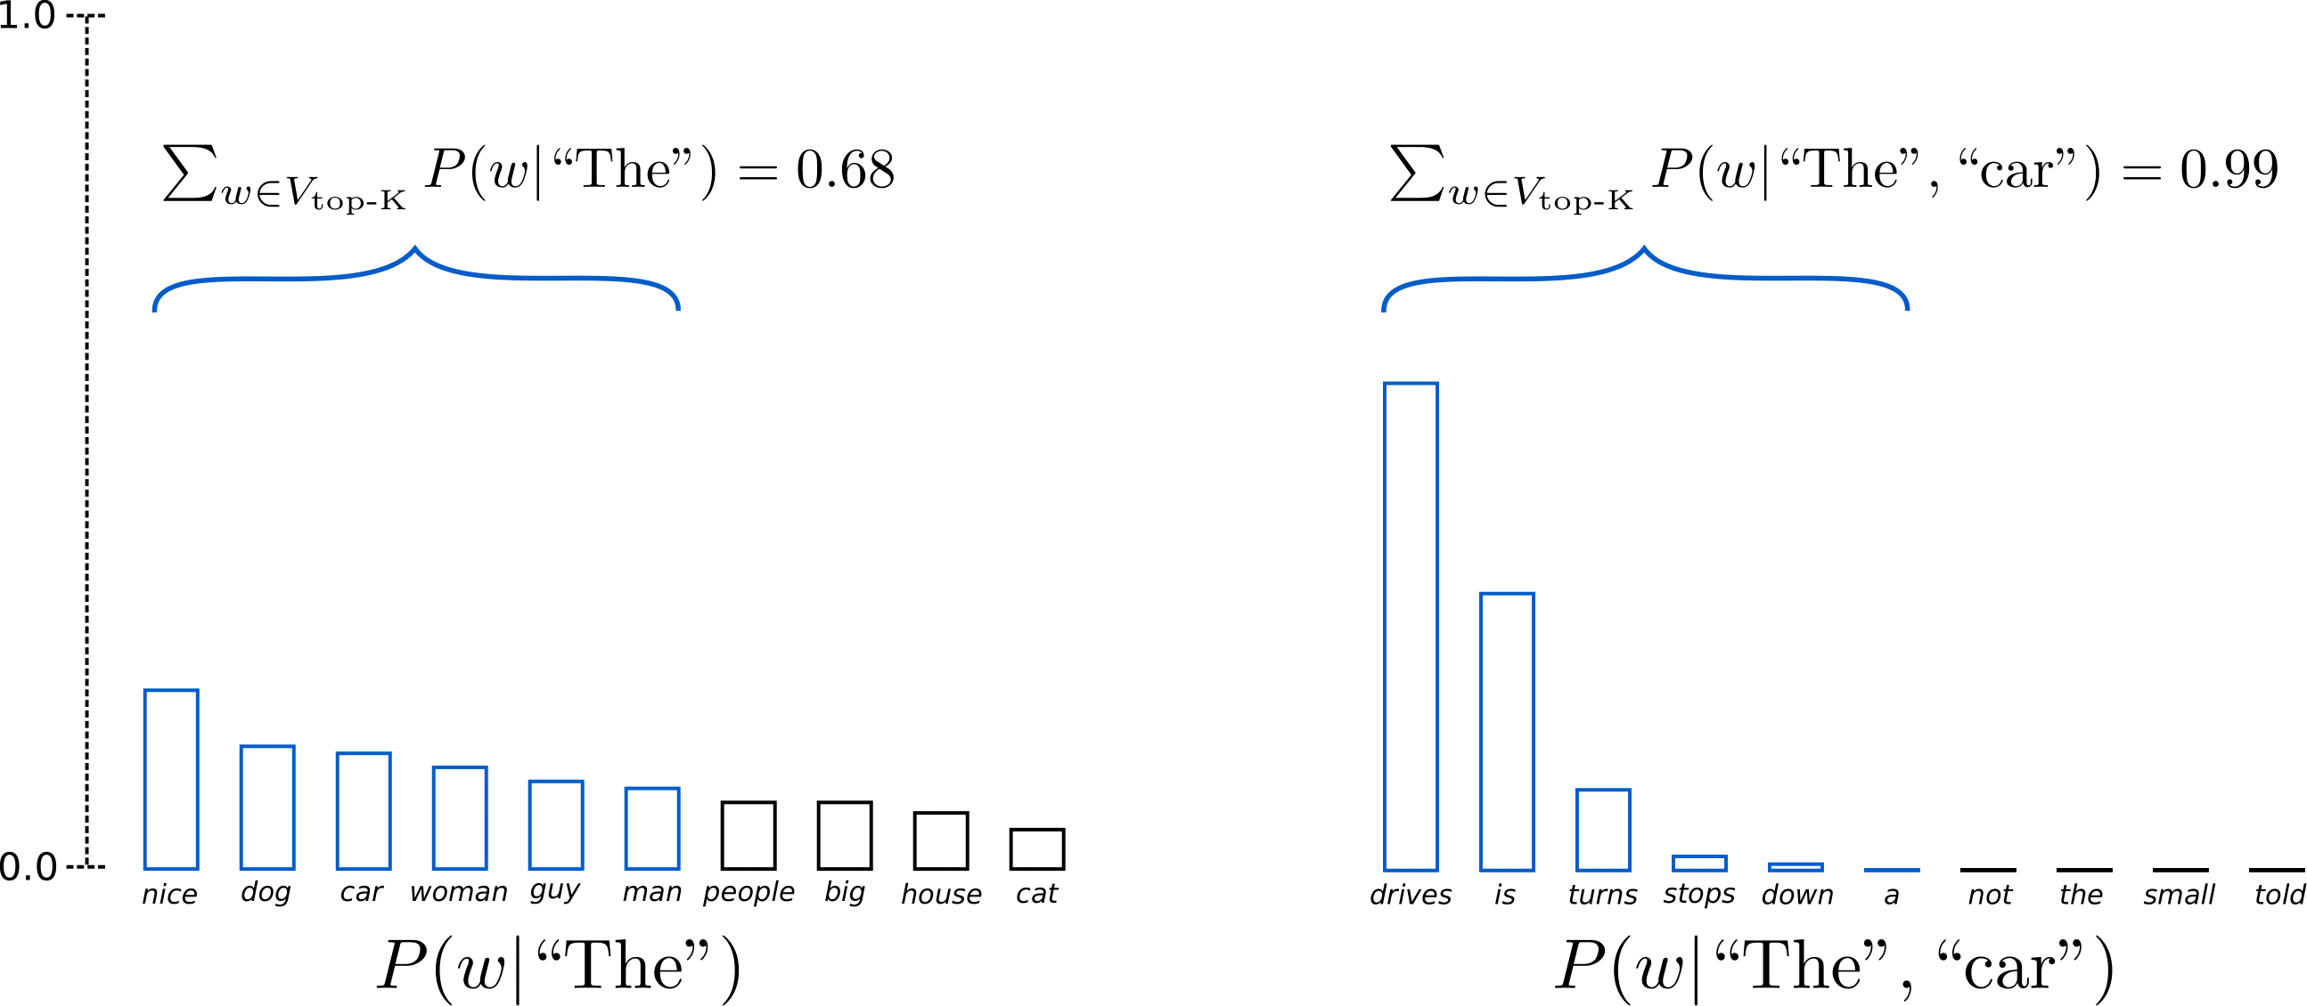
Text generation: Top-K sampling
In Top-K sampling, the K most likely next words are filtered, and the probability mass is redistributed among only those K next words.
GPT2 uses this sampling scheme, which was one of the reasons for its success in story generation.

Slide 18
Top-k Sampling
The generated text is very much human-sounding.
One concern with Top-K sampling is that it does not dynamically adapt the number of words that are filtered from the next word probability distribution.
This can be problematic as some words might be sampled from a very sharp distribution, whereas others from a much flatter.

Slide 19
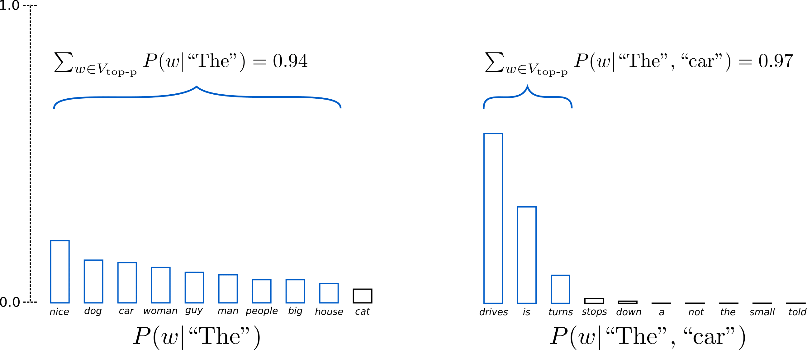
Top-p (nucleus) sampling
Instead of sampling only from the most likely K words, in Top-p sampling chooses from the smallest possible set of words whose cumulative probability exceeds the probability p

Slide 20
Top-p nucleus
The probability mass is redistributed after every step.
This way, the size of the set of words (the number of words in the set) can dynamically increase and decrease according to the next word's probability distribution.
While in theory, Top-p seems more elegant than Top-K, both methods work well in practice.
Top-p can also be combined with Top-K, which can avoid very low-ranked words while allowing for some dynamic selection.

Slide 21
Text decoding conclusion
top-p and top-K sampling produce more fluent text than traditional greedy and beam search on open-ended language generation.
The main issues with greedy and beam search – they generate repetitive word sequences
However, recent research found that this issue is caused by the model (especially how the model is trained) rather than the decoding method
Also, there are scenarios where top-K and top-p sampling suffer from generating repetitive word sequences.
According to human evaluations, beam search can generate more fluent text than Top-p sampling when adapting the model's training objective.

Slide 22
Temperature parameter in decoding
Temperature is a parameter ranging from 0 to 1, which defines the randomness of decoding responses.
The higher the temperature, the more diverse and creative the output would be.
When the temperature is low, an LLM will deliver more conservative and deterministic results.
For example, when the temperature is set to zero, an LLM will produce the same output over and over again when given the same prompt.
As the temperature parameter is raised, an LLM becomes more creative and offers more diverse outputs.
However, when the temperature gets too high, the output can lose meaning and become erratic or nonsensical.

Slide 23
Temperature and top-p/k
A low temperature with a high top-p can lead to coherent text with creative touches
Answers are usually logical and consistent because of the low temperature, but they can still have rich vocabulary and ideas due to the high top-p
This setup is good for educational or informative texts where clarity is crucial, but we also want to keep the reader’s interest
On the other hand, a high temperature with a low top-p might generate common words put together in unpredictable ways
This opposite setting often results in texts where sentences may make sense on their own but as a whole seem disconnected or less logical
The high temperature allows more variation in sentence building, while the low top-p limits word choices to the most likely ones
This can be useful in creative settings where we want unexpected results or to spark new ideas with unusual concept combinations

Slide 24
How to adapt X-Decoders to downstream tasks
Text summarization: We can fine tune GPTx with the text and then start text generation
For example, we can generate 100 tokens with Top-k random sampling with k = 2 which reduces repetition and encourages more abstractive summaries than greedy decoding
We use the first 3 generated sentences in these 100 tokens as the summary
Q/A: We can fine-tune the model using questions-answers pairs (separated by special tokens)
Then input the question followed by the separator
The model will generate answers

